Slide 1

File Organizer
By “Wizards”

Slide 2
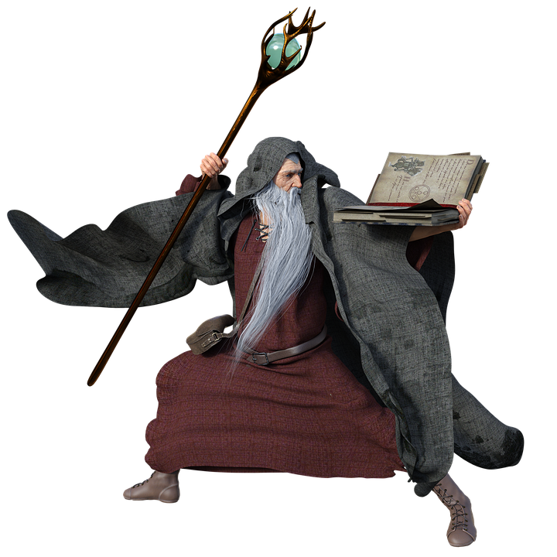
Wizards Members
Dheeraj Vats
Venkatesh Gupta
Upkar Chaudhary
Dharm Vashisth

Slide 3

Phases
Phase 1
We are here.
Organized the files according to months and years.
Phase 2
Will organize the files by keyword.
Phase 3
De-duplicate files from multiple locations.
Will organize by file types.

Slide 4
Requirements
You need only your PC.
No requirement of Internet.
No use of 3rd party.
The best part of this app is it is Open-source.

Slide 5
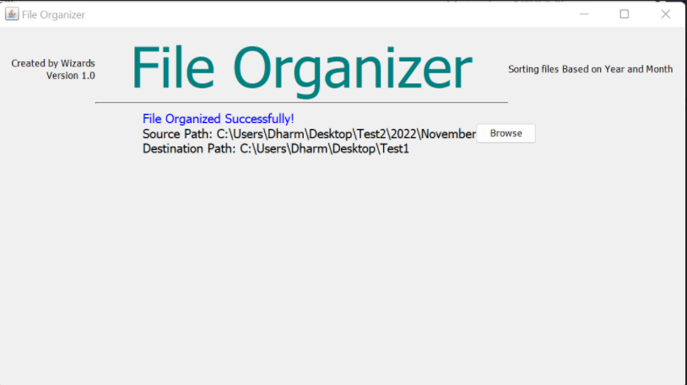
Demo...

Slide 6
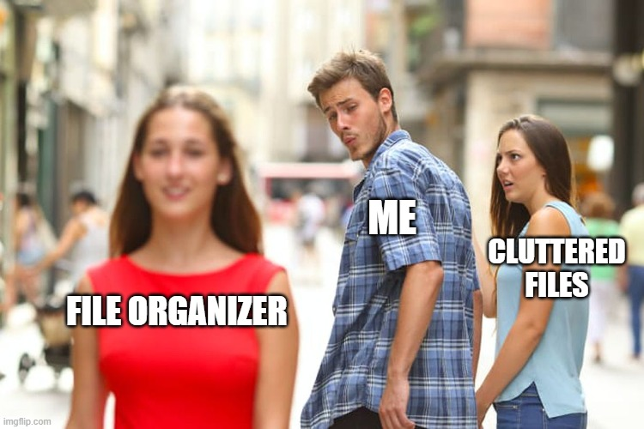
THANK YOU

